Slide 1
Computer Systems for Data Science Topic 2
Borrowed from Shiva Shivakumar
Relational Model and SQL
Notes:
We are going to spend a couple of weeks on this topic. Why are we focusing so much on the relational model?
Because it’s by far the most common way that data scientists think and query data. There are other models, but this is the golden standard, or the model everyone compares against.
For example you may have heard the term NoSQL – this is a large class of data systems that do not offer the full capabilities of SQL, and you are very likely to encounter them at some point in your careers.
However to understand what their limitations are, it’s first important to know what SQL and the full relational model is.

Slide 2
What we’ll cover in this topic
Intuition
Basic relational model
Map-filter-reduce concept
Intro to SQL
Schemas, query structure of SELECT-FROM-WHERE, JOINs
Notes:
This topic will span several weeks, and today we’ll try to cover at least some intuition.

Slide 3
Relational Model: Intution

Slide 4
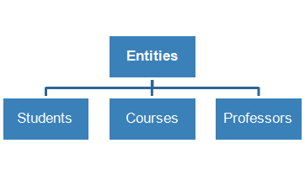
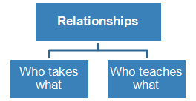
A Motivating Example
A basic Course Management System (CMS):
Entities (e.g., Students, Courses)
Relationships (e.g., Alice is enrolled in CSEE 4121)
Notes:
Imagine you're building a system to manage courses, like courseworks
You have different entities, or things
And you have relationships between these entities
For example, students, courses, etc.

Slide 5
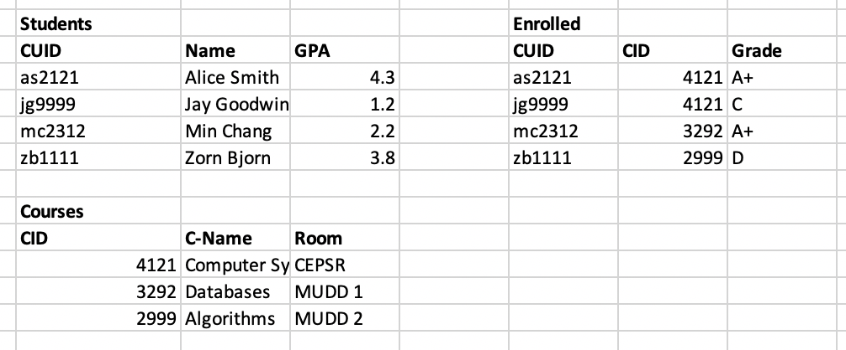
Intuition: Spreadsheet Tables
Logical Schema
Student(cuid: string, name: string, gpa: float)
Courses(cid: string, c-name: string, room: string)
Enrolled(cuid: string, cid: string, grade: string)
Queries [“compute” over tables]
Alice’s GPA?
Jay’s classes?
AVG student GPA?
AVG student GPA in CSEE 4121?
Notes:
What’s the simplest way to model such data? Think spreadsheets. See the table for Student and Courses.
With Spreadsheets, it is easy to (a) make tables for Students, Courses (i.e., the Entities and Relationships) (a) add columns (e.g., add Student’s GPA or # units taken so far) pretty easily.
A schema is the structure of the table.
We have three tables in this example, students, enrolled courses.
The student table schema is for example…
Now we can run queries on these tables. A query is just a question.
For example, you may ask what is Alice Smith’s GPA?
What classes did Jay take?

Slide 6
Relational Model and Schemas
Definition: Data model
Organizing principle of data + operations
Relational model (aka tables)
Simple and most popular
Elegant algebra (E.F. Codd et al)
Definition: Schema
Describes blueprint of table (s)
Every relation has a schema
Logical Schema: describes types, names
Physical Schema: describes data layout
Virtual Schema (Views): derived tables
Notes:
We won’t cover the algebra part, but if you take a full database class that is something they will cover.
A schema is basically the rows and columns, data types
A view is a table you can produce from the original schema

Slide 7
Data Independence
Can we add a new column or attribute without rewriting the application?
Logical Data Independence
Protection from changes in the logical structure of the data
Do you need to care which disks/machines are the data stored on?
Physical Data Independence
Protection from Physical Layout Changes
Notes:
Data independence is a really important concept in database. The idea is that applications do not need to worry about how the data is structured and stored
Why is this important? Imagine you’re a self driving car company. And you collect all the data into huge tables.
These tables are used by all these machine learning models to recognize objects, figure out weather conditions, understand when to start and stop, etc.
Suddenly a data scientist has a eureka moment, and figures out that finding the eyes of humans is super helpful to identifying them in a picture. So you want to add a new column in your table, does the image contain eyes.
Well ideally you’d want to do that without having to rewrite the entire application.
The other part is physical independence. At the end of the day, this database is stored on some storage device somewhere. If Amazon swipes out the device from magnetic disk to flash, as an application developer you shouldn’t have to change your application.

Slide 8
Python Operating on Lists
Basic types
Int
Long
String
Map + Filter
map(function, list)
filter(function, list)
Map applies function to input list
Filter returns sub list that satisfies filter condition
Reduce/Aggregate
reduce(…)
Reduce runs a computation on a list and returns a result
E.g., SUM, AVG, MAX
Notes:
Now hopefully a bunch of you have some familiarity with Python. So we’ll use some concepts from python to give you intuition for how the relational data model works.
So in python we can store variables in all these different variables. Like Int, Long, string etc.
Another thing Python supports is operations on lists. For example, there’s the map operation, which applies a function to an input list. That function could be for example – split up the text into individual words.
Then filter returns a sublist that satisfies a condition – only return words that start with the letter k.
Another list operator in python is reduce. Reduce can run a computation on a list and return a result. For example, sum, average, max.

Slide 9
SQL Queries on Tables (Lists of Rows)
Basic types
Int32, Int64
Char[n]
Float32, Float64
Map + Filter
Single Table Query
SELECT c1, c2
FROM T
WHERE condition;
Reduce/Aggregate
SELECT SUM(c1*c2)
FROM T
WHERE condition
GROUP BY c3;
Multi Table JOIN
SELECT c1, c2
FROM T1, T2
WHERE condition;
Map-Filter-Reduce pattern: Same simple/powerful idea in MapReduce, Hadoop, Spark, etc.
Notes:
This same concept appears also in SQL.
In SQL we also have some types.
This map+filter idea can be applied on a single table. For example what this query does is it takes two columns from a table T (this is the map stage), and then returns only the rows that meet a certain condition, which is the filter stage. The same idea can be applied across multiple tables.
Finally, this reduce aggregate idea also appears in SQL – for example you can take the sum of two columns multiplied one by one, only on rows that meet a certain condition.
Map-Filter-Reduce pattern: Same simple/powerful idea in MapReduce, Hadoop, Spark, etc.

Slide 10
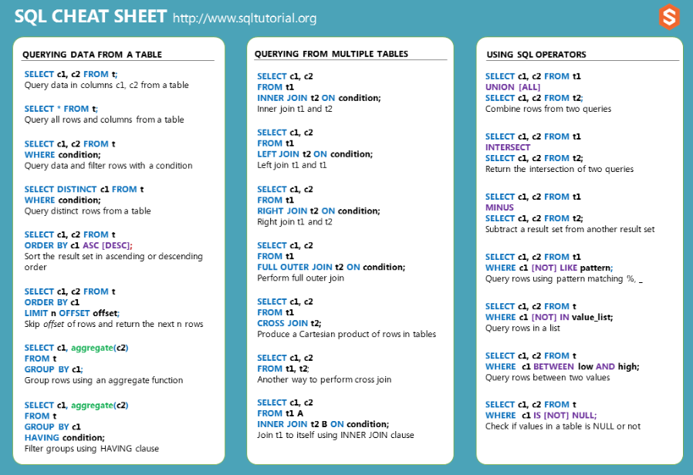
SQL Cheat Sheet (www.sqltutorial.org/sql-cheat-sheet)
Notes:
Good simple cheat sheets on the web summarizing SQL commands. Here’s one. http://www.sqltutorial.org/sql-cheat-sheet/,

Slide 11
Intro to SQL
Notes:
So let’s dive into SQL, which is a language for relational data models.

Slide 12
SQL Introduction
SQL is a standard language for querying and manipulating data
SQL is a very high-level programming language
This works because it is optimized well!
SQL stands for
Structured
Query
Language
Notes:
There are many ways to implement SQL. We will touch on a few examples later on in the course of systems that support it.
BigQuery (the one you’ll do your homework assignments in, is one such system).

Slide 13
SQL is a…
Data Manipulation Language (DML)
Query one or more tables
Insert/delete/modify tuples in tables
Data Definition Language (DDL)
Define relational schemata
Create/alter/delete tables and their attributes
Notes:
SQL is both. We will focus on the first one.

Slide 14
Basic Set Algebra Concepts
List: [1, 1, 2, 3] Ordered, duplicates
Set: {2, 1, 3} Unordered, no duplicates
Multiset: {2, 1, 3, 1} Unordered, duplicates
Unions:
Set: {2, 1, 3} U {2, 3} = {2, 1, 3}
Multiset: {2, 1, 3} U {2, 3} = {2, 1, 3, 2, 3}
Cross-product:
{1, 1, 2, 3} * {y, z} = {1, y}, {1, y}, {2, y}, {3, y}, {1, z}, {1, z}, {2, z}, {3, z}
Notes:
Just a little primer on basic set algebra, which is important for understanding how SQL operations work.
How would a multiset union work in this case?
Cross products are like JOINs

Slide 15
Tables in SQL
Product
PName | Price | Manuf
Gizmo | $19.99 | GizmoWorks
Powergizmo | $29.99 | GizmoWorks
SingleTouch | $149.99 | Canon
MultiTouch | $203.99 | Hitachi
A relation or table is a multiset of tuples/rows having the attributes specified by the schema
Notes:
Why is a table a multiset? It’s not sorted and there can be duplicates

Slide 16
Tables in SQL
Product
PName | Price | Manuf
Gizmo | $19.99 | GizmoWorks
Powergizmo | $29.99 | GizmoWorks
SingleTouch | $149.99 | Canon
MultiTouch | $203.99 | Hitachi
An attribute (or column) is a typed data entry present in each tuple in the relation
NB: Attributes must have an atomic type in standard SQL, i.e. not a list, set, etc.
Notes:
What does typed mean? Every data entry has a pre-defined type, like string or 32bit integer.
An attribute cannot be a list or set in SQL.

Slide 17
Tables in SQL
Product
PName | Price | Manuf
Gizmo | $19.99 | GizmoWorks
Powergizmo | $29.99 | GizmoWorks
SingleTouch | $149.99 | Canon
MultiTouch | $203.99 | Hitachi
A tuple or row or record is a single entry in the table having the attributes specified by the schema

Slide 18

Tables in SQL
Product
PName | Price | Manuf
Gizmo | $19.99 | GizmoWorks
Powergizmo | $29.99 | GizmoWorks
SingleTouch | $149.99 | Canon
MultiTouch | $203.99 | Hitachi
The number of tuples is the cardinality of the relation
The number of attributes is the arity of the relation
Notes:
You may encounter these terms: cardinality and arity

Slide 19
Data Types in SQL
Atomic types:
Characters: CHAR(20), VARCHAR(50)
Numbers: INT, BIGINT, SMALLINT, FLOAT
Others: MONEY, DATETIME…
Every attribute must have an atomic type
Notes:
Char[20] is a set of length of 20 characters. Varchar is a variable length set of characters – it is dynamically allocated, so it’s slower.

Slide 20
Table Schemas
The schema of a table is the table name, its attributes, and their types:
Product(Pname: string, Price: float, Category: string, Manufacturer: string)
Product(Pname: string, Price: float, Category: string, Manufacturer: string)
A key is an attribute whose values are unique; we underline a key
Product(Pname: string, Price: float, Category: string, Manufacturer: string)
Product(Pname: string, Price: float, Category: string, Manufacturer: string)
Notes:
Which attributes are unique?

Slide 21
Key constraints
A key is a minimal subset of attributes that acts as a unique identifier for tuples in a relation
A key is an implicit constraint on which tuples can be in the relation
i.e. if two tuples agree on the values of the key, then they must be the same tuple!
Students(cuid:string, name:string, gpa: float)
1. Which would you select as a key?
2. Is a key always guaranteed to exist?
3. Can we have more than one key?
Notes:
The name is probably not a good key– could have duplicates
Does every table need a key? Basically yes. There needs to be some kind of unique identifier.
Yes we can have more than columns that can be candidates for keys.

Slide 22
Declaring Schema
Students(cuid: string, name: string, gpa: float)
CREATE TABLE Students (
cuid CHAR(20),
name VARCHAR(50),
gpa float,
PRIMARY KEY (cuid),
)
Notes:
We need to have one primary key.

Slide 23
NULL and NOT NULL
To say “don’t know the value” we use NULL
Students(cuid:string, name:string, gpa: float)
cuid | name | gpa
123 | Alice | 3.9
143 | Jim | NULL
Say, Jim just enrolled in his first class.
In SQL, we may constrain a column to be NOT NULL,
e.g., “name” in this table
Notes:
Which one of these legitimately can be a NULL?

Slide 24
General Constraints
We can actually specify arbitrary assertions
E.g. “There cannot be 25 people in the DB class”
In practice, we don’t specify many such constraints. Why?
Performance!
Whenever we do something ugly (or avoid doing something convenient) it’s for the sake of performance
Notes:
Why are constraints slow? Because they need to be checked at every single operation – this slows things down a lot!

Slide 25
Summary of Schema Information
Schema and Constraints are how databases understand the semantics (meaning) of data
SQL supports general constraints:
Keys and foreign keys are most important

Slide 26
Single Table Query

Slide 27
SQL Query
Basic form (there are many many more bells and whistles)
SELECT <attributes>
FROM <one or more relations>
WHERE <conditions>
Call this a SFW query.

Slide 28
Simple SQL Query: Selection
PName | Price | Category | Manuf
Gizmo | $19.99 | Gadgets | GWorks
Powergizmo | $29.99 | Gadgets | GWorks
SingleTouch | $149.99 | Photography | Canon
MultiTouch | $203.99 | Household | Hitachi
Selection is the operation of filtering a relation’s tuples on some condition
SELECT *
FROM Product
WHERE Category = ‘Gadgets’
PName | Price | Category | Manuf
Gizmo | $19.99 | Gadgets | GWorks
Powergizmo | $29.99 | Gadgets | GWorks

Slide 29
Simple SQL Query: Projection
PName | Price | Category | Manuf
Gizmo | $19.99 | Gadgets | GWorks
Powergizmo | $29.99 | Gadgets | GWorks
SingleTouch | $149.99 | Photography | Canon
MultiTouch | $203.99 | Household | Hitachi
Projection is the operation of producing an output table with tuples that have a subset of their prior attributes
SELECT Pname, Price, Manufacturer
FROM Product
WHERE Category = ‘Gadgets’
PName | Price | Manuf
Gizmo | $19.99 | GWorks
Powergizmo | $29.99 | GWorks

Slide 30
Notation
Input Schema
Product(PName, Price, Category, Manufacturer)
SELECT Pname, Price, Manufacturer
FROM Product
WHERE Category = ‘Gadgets’
Output Schema
Answer(PName, Price, Manfacturer)

Slide 31
A Few Details
SQL commands are case insensitive:
Same: SELECT, Select, select
Same: Product, product
Values are not:
Different: ‘Seattle’, ‘seattle’
Use single quotes for constants:
‘abc’ - yes
“abc” - no

Slide 32
LIKE: Simple String Pattern Matching
SELECT *
FROM Products
WHERE PName LIKE ‘%gizmo%’
s LIKE p: pattern matching on strings
p may contain two special symbols:
% = any sequence of characters
_ = any single character

Slide 33
DISTINCT: Eliminating Duplicates
Category
Gadgets
Photography
Household
SELECT DISTINCT Category
FROM Product
Category
Gadgets
Gadgets
Photography
Household
Versus
SELECT Category
FROM Product

Slide 34
ORDER BY: Sorting the Results
SELECT PName, Price, Manufacturer
FROM Product
WHERE Category=‘gizmo’ AND Price > 50
ORDER BY Price, PName
Ties are broken by the second attribute on the ORDER BY list, etc.
Ordering is ascending, unless you specify the DESC keyword.

Slide 35
Multi-Table Query

Slide 36
Foreign Key constraints
Suppose we have the following schema :
Students(cuid: string, name: string, gpa: float)
Enrolled(student_id: string, cid: string, grade: string)
And we want to impose the following constraint:
Only bona fide students may enroll in courses’ i.e. a student
must appear in the Students table to enroll in a class
Students
Enrolled
cuid | name | gpa
102 | Bob | 3.9
123 | Mary | 3.8
student_id | cid | grade
102 | 564 | A
123 | 537 | A+
We say that cuid is a foreign key that refers to Students

Slide 37
Declaring Foreign Keys
Students(cuid: string, name: string, gpa: float)
Enrolled(student_id: string, cid: string, grade: string)
CREATE TABLE Enrolled (
student_id CHAR(20),
cid CHAR(20),
grade CHAR(10),
PRIMARY KEY (student_id, cid),
FOREIGN KEY (student_id) REFERENCES Students(cuid)
)

Slide 38
Foreign Keys and update operations
Students(cuid: string, name: string, gpa: float)
Enrolled(student_id: string, cid: string, grade: string)
What if we insert a tuple into Enrolled, but no corresponding student?
INSERT is rejected (foreign keys are constraints)!
What if we delete a student?
1.Disallow the delete
2.Remove all of the courses for that student
3.SQL allows a third via NULL
DBA chooses

Slide 39
Keys and Foreign Keys
Company
CName | StockPrice | Country
GizmoWorks | 25 | USA
Canon | 65 | Japan
Hitachi | 15 | Japan
What is a foreign key vs. a key here?
Product
PName | Price | Category | Manufacturer
Gizmo | $19.99 | Gadgets | GizmoWorks
Powergizmo | $29.99 | Gadgets | GizmoWorks
SingleTouch | $149.99 | Photography | Canon
MultiTouch | $203.99 | Household | Hitachi
Notes:
In Company the key is Cname
In Product the key is Pname, and the foreign key is Manufacturer, which references CName

Slide 40
JOINs and Aggregations

Slide 41
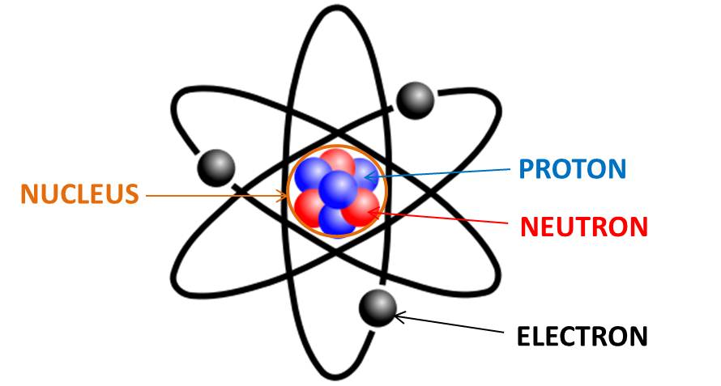

Reminder on schemas
We’ll use different Tables/tuples, for examples
to build ideas
Data about local areas (for real-world examples)
Product(PName, Price, Category, Manufacturer)
Company(CName, StockPrice, Country)
Students(cuid: string, name: string, gpa: float)
Enrolled(student_id: string, cid: string, grade: string)
SolarPanel(region_name: string, kw_total: float, carbon_offset_ton_metrics: float, … )
Census(zipcode: string, population: int, ...)
Pollution(zipcode: string, Particle_count: int…)
BikeShare(zipcode: string, trip_origin: float, trip_end: float, …)
...

Slide 42
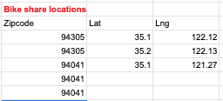



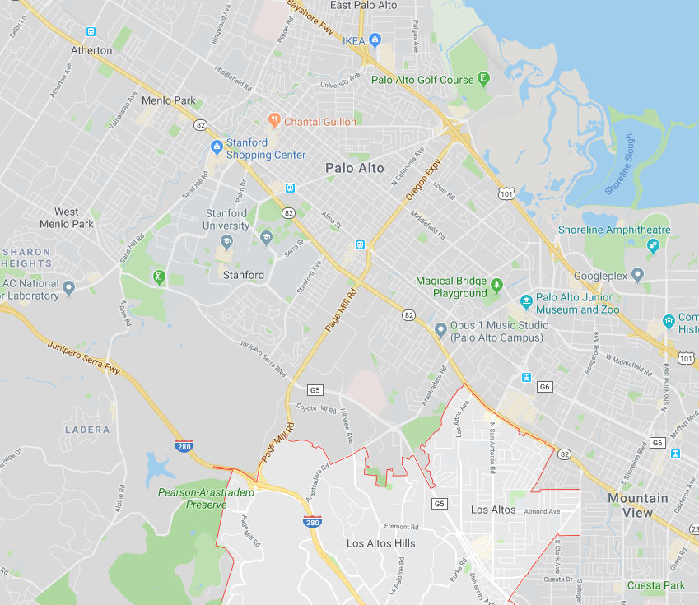
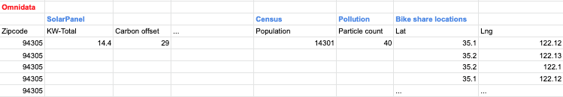
Option 1: Organized tables, with 10s-100s of columns)
Option 2: ‘FrankenTable’ (with 1000s of columns)
????

Slide 43
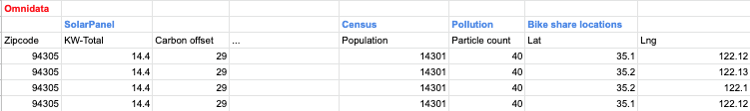
Option 1: Organized tables, with 10s-100s of columns)
Trade offs?
Reads? Writes?
100s - thousands of applications reading/writing data
⇒ Hybrids: 1 column → all columns
(Week 7: What’s a good schema design?)
Option 2: ‘FrankenTable’ (with 1000s of columns)

Slide 44
Joins
A join between tables returns all unique combinations of their tuples which meet some specified join condition
Product(PName, Price, Category, Manufacturer)
Company(CName, StockPrice, Country)
Ex: Find all products under $200 manufactured in Japan; return their names and prices.
SELECT PName, Price
FROM Product, Company
WHERE Manufacturer = CName
AND Country=‘Japan’
AND Price <= 200

Slide 45
Joins
Product
Company
PName | Price | Category | Manufacturer
Gizmo | $19 | Gadgets | GizmoWorks
Powergizmo | $29 | Gadgets | GizmoWorks
SingleTouch | $149 | Photography | Canon
MultiTouch | $203 | Household | Hitachi
CName | Stock Price | Country
GizmoWorks | 25 | USA
Canon | 65 | Japan
Hitachi | 15 | Japan
SELECT PName, Price
FROM Product, Company
WHERE Manufacturer = CName
AND Country=‘Japan’
AND Price <= 200
PName | Price
SingleTouch | $149

Slide 46
An example of SQL semantics
SELECT R.A
FROM R, S
WHERE R.A = S.B
A
3
3
Output
R
A
1
3
A | B | C
1 | 2 | 3
1 | 3 | 4
1 | 3 | 5
3 | 2 | 3
3 | 3 | 4
3 | 3 | 5
Cross
Product
Apply Selections / Conditions
Apply Projection
S
B | C
2 | 3
3 | 4
3 | 5
A | B | C
3 | 3 | 4
3 | 3 | 5

Slide 47
Note: we say “semantics” not “execution order”
The preceding slides show what a join means
Not actually how the DBMS executes it under the covers

Slide 48
Aggregation
SELECT AVG(price)
FROM Product
WHERE maker = “Toyota”
SELECT COUNT(*)
FROM Product
WHERE year > 1995
SQL supports several aggregation operations:
SUM, COUNT, MIN, MAX, AVG
Except COUNT, all aggregations apply to a single attribute

Slide 49
More Examples
Purchase(product, date, price, quantity)
SELECT SUM(price * quantity)
FROM Purchase
What do these mean?
SELECT SUM(price * quantity)
FROM Purchase
WHERE product = ‘bagel’

Slide 50
Simple Aggregations
Purchase
Product | Date | Price | Quantity
bagel | 10/21 | 1 | 20
banana | 10/3 | 0.5 | 10
banana | 10/10 | 1 | 10
bagel | 10/25 | 1.50 | 20
SELECT SUM(price * quantity)
FROM Purchase
WHERE product = ‘bagel’
50 (= 1*20 + 1.50*20)

Slide 51
Grouping and Aggregation
Purchase(product, date, price, quantity)
SELECT product,
SUM(price * quantity) AS TotalSales
FROM Purchase
WHERE date > ‘10/1/2005’
GROUP BY product
Find total sales after 10/1/2005 per product.
Let’s see what this means…

Slide 52
Grouping and Aggregation
SELECT product,
SUM(price * quantity) AS TotalSales
FROM Purchase
WHERE date > ‘10/1/2005’
GROUP BY product
Semantics of the query:
1. Compute the FROM and WHERE clauses
2. Group by the attributes in the GROUP BY
3. Compute the SELECT clause: grouped attributes and aggregates

Slide 53
1. Compute the FROM and WHERE clauses
SELECT product, SUM(price*quantity) AS TotalSales
FROM Purchase
WHERE date > ‘10/1/2005’
GROUP BY product
Product | Date | Price | Quantity
Bagel | 10/21 | 1 | 20
Bagel | 10/25 | 1.50 | 20
Banana | 10/3 | 0.5 | 10
Banana | 10/10 | 1 | 10
FROM

Slide 54
2. Group by the attributes in the GROUP BY
SELECT product, SUM(price*quantity) AS TotalSales
FROM Purchase
WHERE date > ‘10/1/2005’
GROUP BY product
Product | Date | Price | Quantity
Bagel | 10/21 | 1 | 20
Bagel | 10/25 | 1.50 | 20
Banana | 10/3 | 0.5 | 10
Banana | 10/10 | 1 | 10
GROUP BY
Product | Date | Price | Quantity
Bagel | 10/21 | 1 | 20
 | 10/25 | 1.50 | 20
Banana | 10/3 | 0.5 | 10
 | 10/10 | 1 | 10

Slide 55
3. Compute the SELECT clause: grouped attributes and aggregates
SELECT product, SUM(price*quantity) AS TotalSales
FROM Purchase
WHERE date > ‘10/1/2005’
GROUP BY product
Product | Date | Price | Quantity
Bagel | 10/21 | 1 | 20
 | 10/25 | 1.50 | 20
Banana | 10/3 | 0.5 | 10
 | 10/10 | 1 | 10
SELECT
Product | TotalSales
Bagel | 50
Banana | 15

Slide 56
HAVING Clause
SELECT product, SUM(price*quantity)
FROM Purchase
WHERE date > ‘10/1/2005’
GROUP BY product
HAVING SUM(quantity) > 100
Same query as before, except that we consider only products that have more than
100 buyers
HAVING clauses contains conditions on aggregates
Whereas WHERE clauses condition on individual tuples…

Slide 57
RECAP: Joins
By default, joins in SQL are “inner joins”:
Product(name, category)
Purchase(prodName, store)
SELECT Product.name, Purchase.store
FROM Product, Purchase
WHERE Product.name = Purchase.prodName
Both equivalent:
Both INNER JOINS!
SELECT Product.name, Purchase.store
FROM Product
JOIN Purchase ON Product.name = Purchase.prodName

Slide 58
Outer Joins
An outer join returns tuples from the joined relations that don’t have a corresponding tuple in the other relations
I.e. If we join relations A and B on a.X = b.X, and there is an entry in A with X=5, but none in B with X=5…
A LEFT OUTER JOIN will return a tuple (a, NULL)!
Left outer joins in SQL:
SELECT Product.name, Purchase.store
FROM Product
LEFT OUTER JOIN Purchase ON
Product.name = Purchase.prodName
Now we’ll get products even if they didn’t sell

Slide 59
INNER JOIN
Product
Purchase
name | category
iphone | media
Tesla | car
Ford Pinto | car
prodName | store
iPhone | Apple store
Tesla | car
iPhone | Apple store
name | store
iPhone | Apple store
iPhone | Apple store
Tesla | car
SELECT Product.name, Purchase.store
FROM Product
INNER JOIN Purchase
ON Product.name = Purchase.prodName
Note: another equivalent way to write an INNER JOIN!

Slide 60
LEFT OUTER JOIN
Product
Purchase
name | category
iphone | media
Tesla | car
Ford Pinto | car
prodName | store
iPhone | Apple store
Tesla | car
iPhone | Apple store
name | store
iPhone | Apple store
iPhone | Apple store
Tesla | car
Ford Pinto | NULL
SELECT Product.name, Purchase.store
FROM Product
LEFT OUTER JOIN Purchase
ON Product.name = Purchase.prodName

Slide 61
Other Outer Joins
Left outer join:
Include the left tuple even if there’s no match
Right outer join:
Include the right tuple even if there’s no match
Full outer join:
Include the both left and right tuples even if there’s no match

Slide 62
Nested Queries

Slide 63
SQL is Compositional
Can construct powerful query chains (e.g., f(g(...(x)))
Inputs / outputs are multisets
⇒ Output of one query can be input to another (nesting)!
⇒ Including on same table

Slide 64
Nested queries: Sub-queries Return Relations
Company(name, city) Product(name, maker) Purchase(id, product, buyer)
SELECT c.city
FROM Company c
WHERE c.name IN (
SELECT pr.maker
FROM Purchase p, Product pr
WHERE p.product = pr.name
AND p.buyer = ‘Mickey‘)
Companies making products bought by Mickey”
Location of companies?

Slide 65
Nested queries: Sub-queries Return Relations
Company(name, city) Product(name, maker) Purchase(id, product, buyer)
SELECT c.city
FROM Company c
WHERE c.name IN (
SELECT pr.maker
FROM Purchase p, Product pr
WHERE p.product = pr.name
AND p.buyer = ‘Mickey‘)
Companies making products bought by Mickey”
Location of companies?

Slide 66
Subqueries Return Relations
You can also use operations of the form:
s > ALL R
s < ANY R
EXISTS R
Ex:
Product(name, price, category, maker)
SELECT name
FROM Product
WHERE price > ALL(
SELECT price
FROM Product
WHERE maker = ‘Gizmo-Works’)
SELECT p1.name
FROM Product p1
WHERE p1.maker = ‘Gizmo-Works’
AND EXISTS(
SELECT p2.name
FROM Product p2
WHERE p2.maker <> ‘Gizmo-Works’
AND p1.name = p2.name)
<> means !=
Find products that are more expensive than all those produced by “Gizmo-Works”
Find ‘copycat’ products, i.e. products made by competitors with the same names as products made by “Gizmo-Works”
Note the scoping of the variables!

Slide 67
Example: Complex Correlated Query
Product(name, price, category, maker, year)
SELECT DISTINCT x.name, x.maker
FROM Product AS x
WHERE x.price > ALL(
SELECT y.price
FROM Product AS y
WHERE x.maker = y.maker
AND y.year < 1972)
Find products (and their manufacturers) that are more expensive than all products made by the same manufacturer before 1972
Can be very powerful (also much harder to optimize)

